Slide 1
Ecosystem Services Part 1: Defining and Valuing Nature
Student Version

Slide 2
What Is Value?
Question 1.
How can you describe the value you place on something?
How would you compare something you value to something different that another person values? (e.g., soil health vs. swimming in a clean lake)
Would that value change if you lived in a different part of the world or had less money?

Slide 3
What Are Ecosystem Services (ES)?
Ecosystem services are the benefits that humans receive from nature, sometimes called natural capital.
Examples include clean air and water; flood control; arboreal shade and cooling; pollination from birds and insects; raw materials and wild food; and fertile soil for farming.
In theory, these ES can be valued using standard methods developed by economists that can be in monetary or indirect non-monetary terms.

Slide 4
Value from an Ecosystem Services Perspective
Value is what something that’s associated with nature is worth to people.
What an ES costs and the value or benefits it delivers are not necessarily equal.
Nature’s values need not be revealed in markets.
The value of foregone activities (“opportunity cost”) must be considered.

Slide 5
How Ecologists Have Categorized Ecosystem Services
Question 2. Which of the following are not ecosystem services?

Slide 6
Types of ES Value
Extractive Use Value
Value from “consuming” natural resource
Question 3. Can you list natural resource examples related for each of the six types of values?
Use Value
Non-Extractive Use Value
Non-consumptive value
Indirect Use Value
Value from the functioning of ecosystems
Economic Value
Existence
Value
Value from knowing resource exists
Non-Use Value
Option
Value
Value from preserving future use
Bequest
Value
Value from preserving for future generations
Note: This is only one way to categorize types of ES value.

Slide 7
Valuation Methods: Market-Based Price
Is a type of use value
Is sold commercially so data are available in monetary units
Is easiest for determining value and creating policies but most ecosystem services do not have markets
Is assumed to represent the social benefits that an additional unit confers
Question 4. Why do you think the method is linked to getting more or having less? i.e., rather than a fixed amount of the service

Slide 8
Valuation Methods: Market-Based Price
Is a type of use value
Is sold commercially so data are available in monetary units
Is easiest for determining value and creating policies but most ecosystem services do not have markets
Is assumed to represent the social benefits an additional unit confers
Question 5. What is an example of something in nature that can be monetized based on markets (i.e.,
has commercial value)?

Slide 9
Valuation Methods: Market-Based Cost Avoidance
Is a type of indirect use value
Nature provides the service, but it could be replaced through commercial markets
Could refer to the value of preserving nature to avoid future costs that will occur
Is sometimes called replacement cost
Question 6. What is an example of something that could be valued based on what it would cost to get it if nature did not provide it?

Slide 10
Question 7. How might you go about assigning value to each of the six types of ecosystem services? (i.e., what method would you use?)
Extractive Use Value
Value from “consuming” natural resource
Use Value
Non-Extractive Use Value
Non-consumptive value
Indirect Use Value
Value from the functioning of ecosystems
Economic Value
Existence
Value
Value from knowing resource exists
Non-Use Value
Option
Value
Value from preserving future use
Bequest
Value
Value from preserving for future generations

Slide 11
Valuation Methods: Non-Market
They are not estimated based on market prices (i.e., not commercial).
They can observe choices, but not prices.
Most ecosystem services must be valued using non-monetary economic methods.
They require that a link be established between changes in the quantity or quality of the resource and changes in the stated or observed behavior of people.
e.g., changes in air quality may result in people moving to another area.

Slide 12
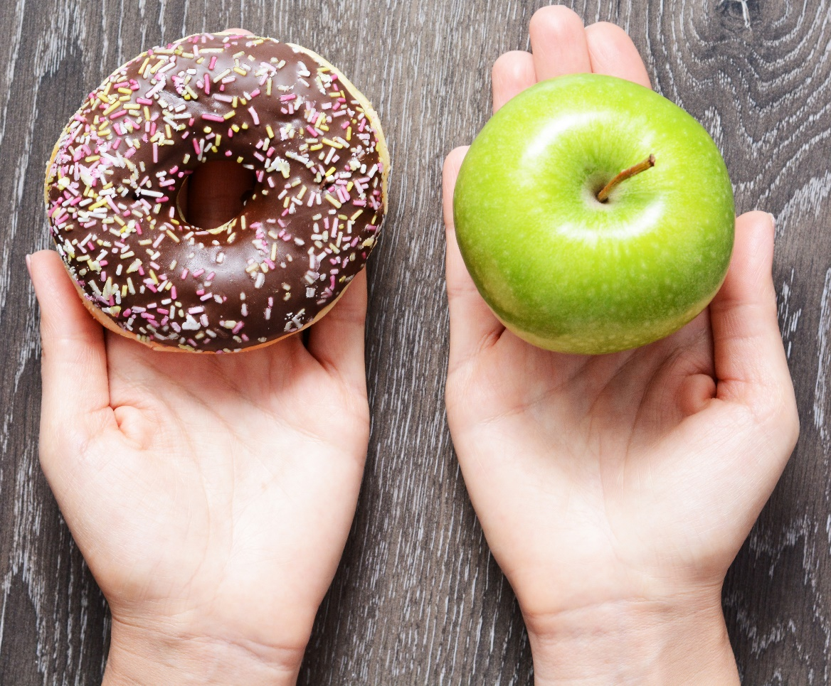
Valuation Methods: Non-Market
Methods involve discovering preferences
revealed preferences – based on choices/decisions people make
stated preferences – based on what people say their preferences are
Once preferences are determined, they can sometimes be monetized
e.g., by stating their willingness to pay for something
Question 8. How might you implement these two methods to determine the value of a natural resource or natural process?

Slide 13
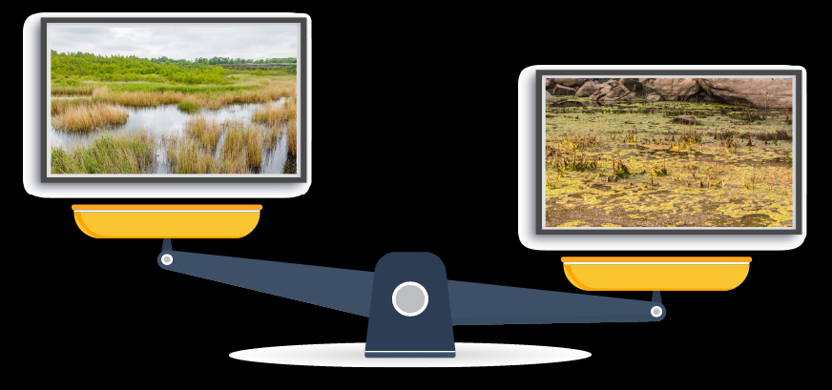
Stated Preference Method Example
Question 9. If you are shown the below two images on computer screens, which one do you prefer? By how much (more)? Why?
Notes:
Instructor:

Slide 14
Stated Preference Method Example
Question 10. What factors other than what appears to be the health of the wetland on the left might apply to your preferences? Hint: Think about the
multi-dimensional nature of ecosystem services.

Slide 15
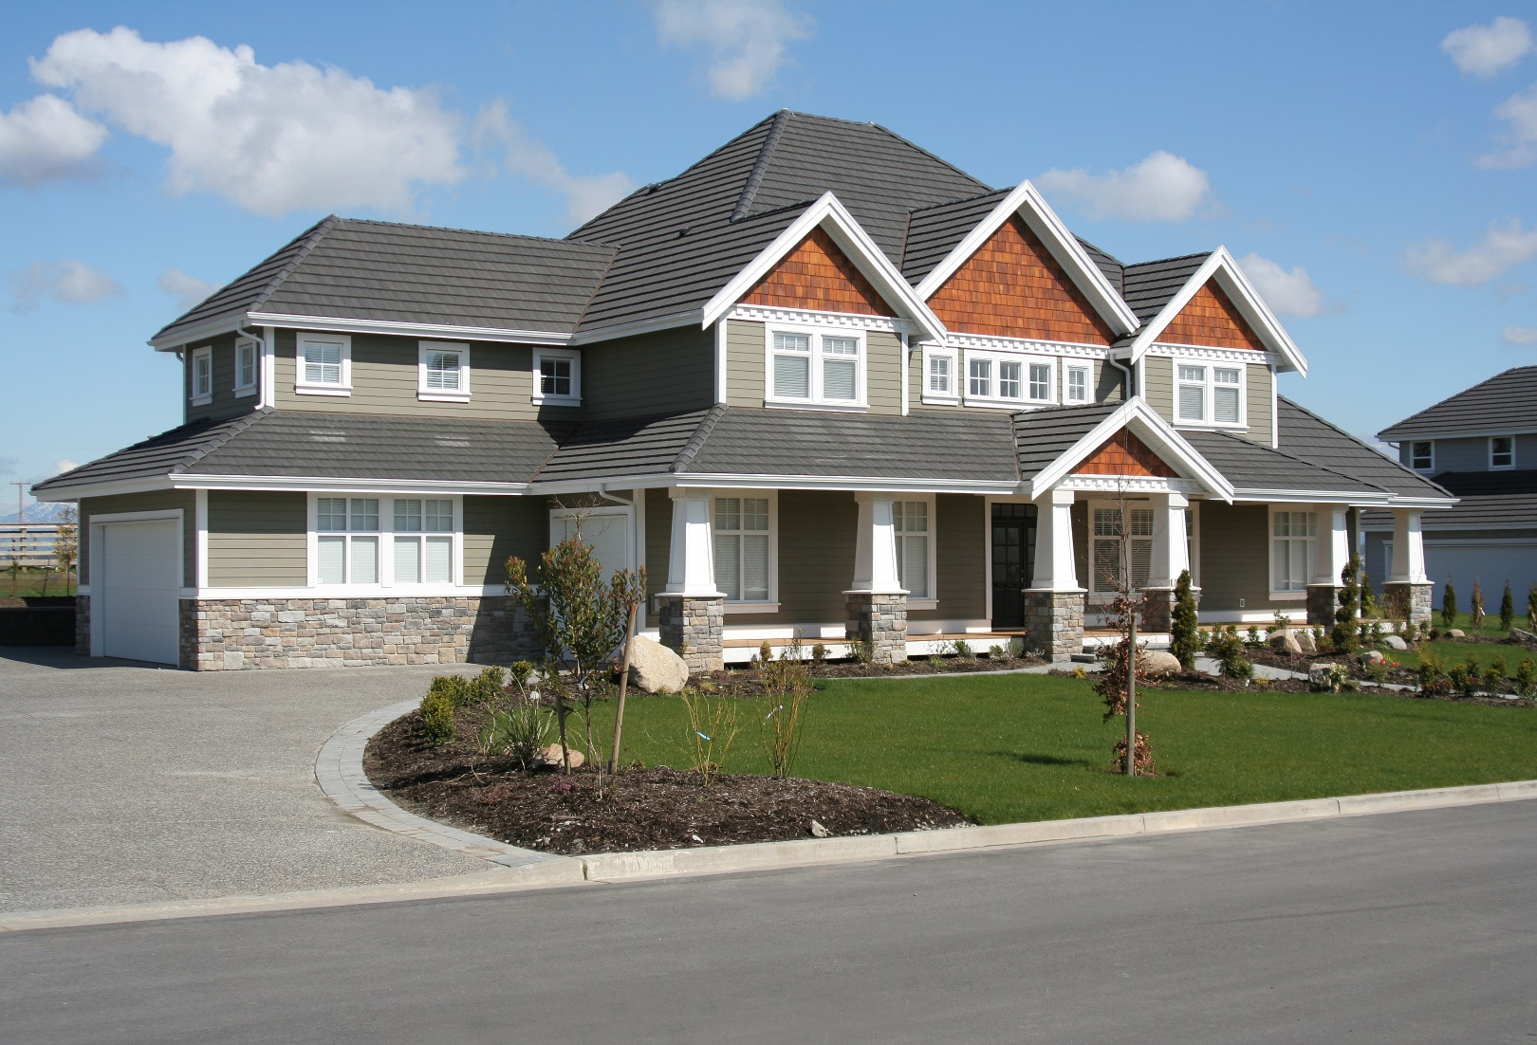
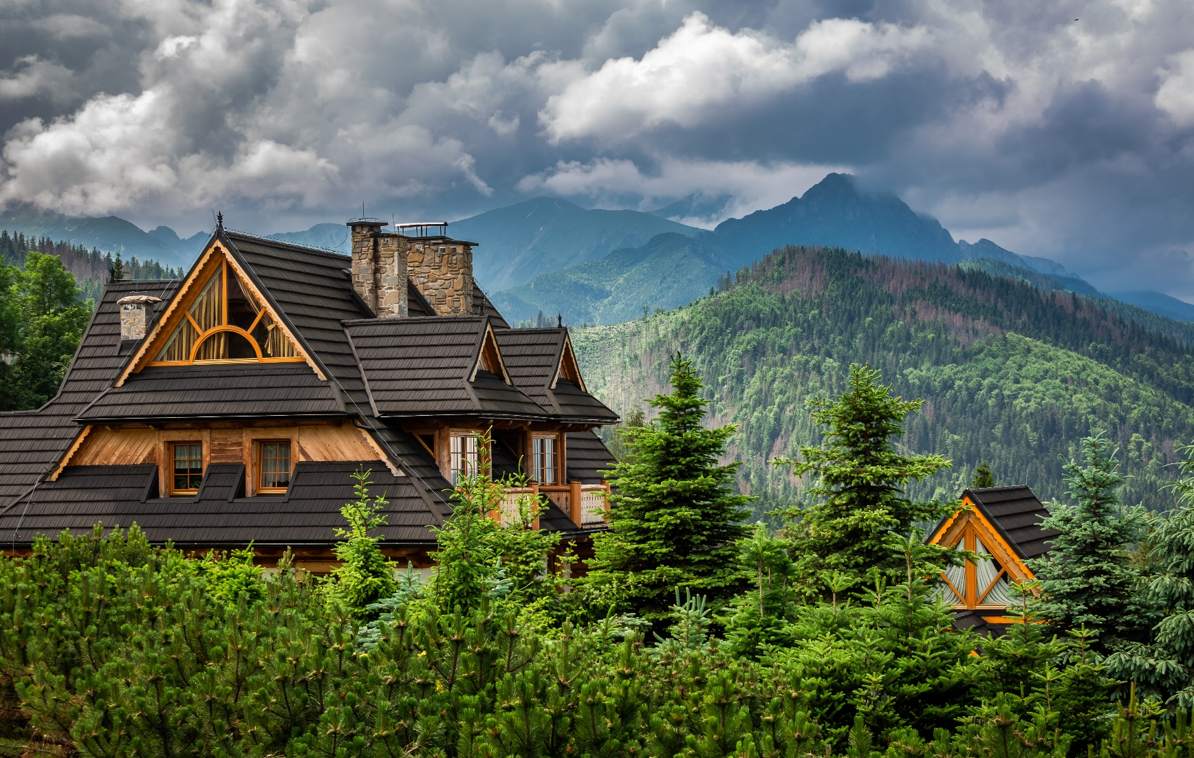
Revealed Preference Method Example
Question 11. How might these two properties differ in terms of how much they sold for? What do you think the ecosystem service is in this example?
Question 12. What are some other examples in which preferences can be revealed that cannot be easily linked to a $ number?
SOLD!
SOLD!

Slide 16
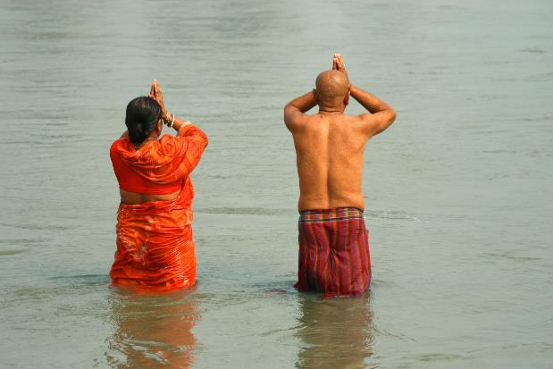
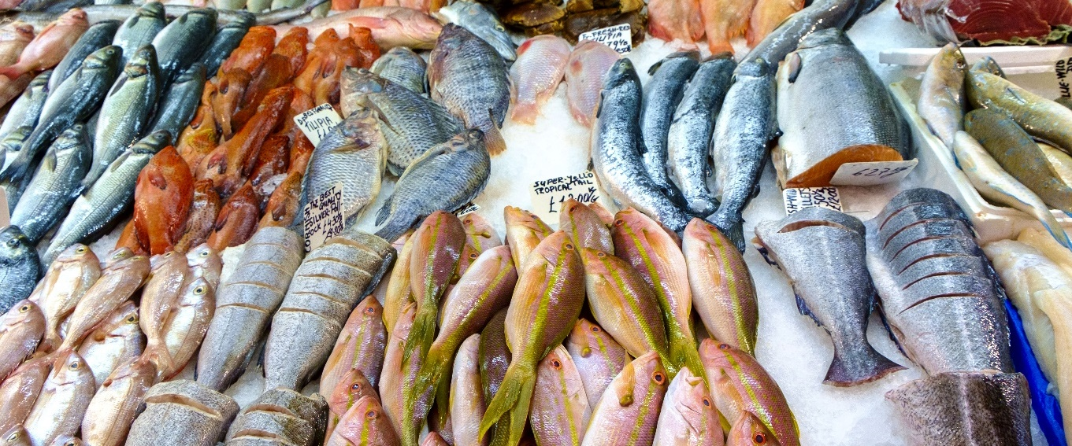
Question 13. What are several reasons that valuation of ecosystem services is useful?

Slide 17
Why is valuation of ES useful?
Why Is Valuation of ES Useful?
Provides a common unit of measure
Uses of natural resources create a range of impacts, usually not in comparable units (generated revenues, changes in fish stocks, loss of tourists, water quality changes, reef degradation).
Facilitates decision making
Benefit-Cost Analysis (BCA) is a systematic enumeration of the gains (benefits) and losses (costs) of particular decisions in common units, for comparison purposes.
Serves as a good public communication tool
Uses of natural resources create a range of impacts, usually not in comparable units (generated revenues, changes in fish stocks, loss of tourists, water quality changes, reef degradation).

